Slide 1
Ellise Ski Shop Database
Eddie Deschapelles, Laura Yan, Lauren Hanley, Liren Zhou
December 14th, 2023
Group B
Notes:
Eddie

Slide 2
Table of contents
01
02
03
04
05
06
Project Framing
Entity-Relation Diagram
Relational Schema Mapping
Data Sources
Queries
Visualizations
Notes:
Eddie

Slide 3
About our company
Ellise began as a small ski shop in 2018. With the rapid expansion and growing popularity of Ellise over the past few years, there is a pressing need for an ER database system to comprehensively document all information and transaction activities for the Ellise ski shop chain.
Notes:
Eddie

Slide 4
What are the issues?
Ineffective
Inaccurate
Disorganized
We are proposing a new database system that streamlines all information about the Ellise ski shops and appropriately organizes details about employees, shops, products, customers, sales, and rentals.
Ellise’s current database system does not accurately track Ellise’s employees. Our ER system differentiates between sales and management positions.
Our ER system focuses on ensuring that goods and customers are accurately accounted for and tracked.
Notes:
Eddie

Slide 5
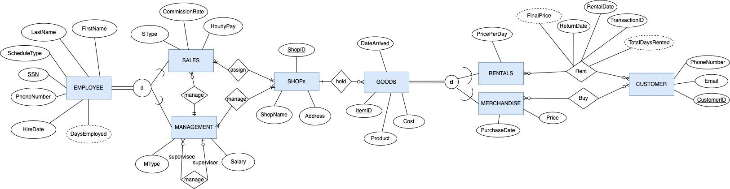
Entity-Relation Diagram
Notes:
Eddie

Slide 6

Relational Schema Mapping
EMPLOYEE( SSN, ScheduleType, FirstName, LastName, PhoneNumber, HireDate)
MANAGEMENT( SSN(FK), Salary, MType, Supervisor[FK] )
SALES ( SSN(FK), CommissionRate, SType, HourlyPay, ShopID(FK), Supervisor[FK] )
Manage ( SSN(FK), shopID(FK) )
SHOPS ( ShopID, Address, ShopName )
GOODS ( ItemID, Cost, Product, DateArrived, shopID[FK])
RENTALS ( ItemID(FK), PricePerDay )
Rent ( ItemID(FK), CustomerID(FK), RentalDate, ReturnDate, TransactionID)
MERCHANDISE ( ItemID(FK), CustomerID(FK), PurchaseDate, Price)
CUSTOMER (CustomerID, PhoneNumber, Email)
Notes:
Eddie

Slide 7
Data Sources
For our data sources, we primarily used random data from an online platform.
Employee, Goods, Rentals, Merchandise & Customer Tables: We randomly generated the data for these tables with data from Mockaroo.com.
Shops Table: This data was collected from ski town locations in Colorado.
Notes:
Laura

Slide 8
Query Report #1
Purpose
SQL Commands
The purpose is to retrieve the top-selling products based on the total quantity sold and total income.
This financial information helps the Ellise team understand customer buying patterns, which informs inventory, pricing, and promotions.
SELECT Product, COUNT(Merchandise.ItemId) AS TotalQuantitySold, SUM(Price) AS TotalIncome
FROM Merchandise
JOIN Goods ON Merchandise.ItemId = Goods.ItemID
WHERE CustomerID <> ''
GROUP BY Product
ORDER BY TotalQuantitySold DESC;
.
Notes:
Laura

Slide 9
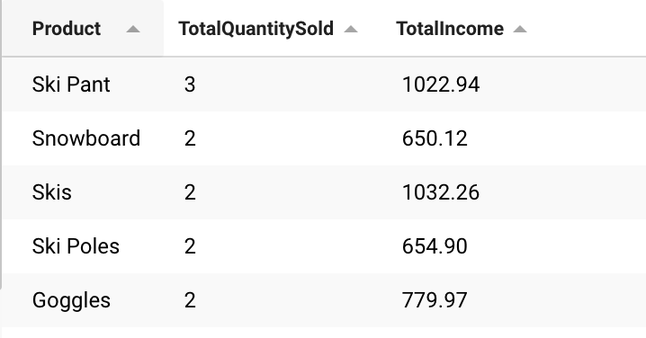
Query Report #1 Output
Notes:
Laura

Slide 10
Query Report #2
Purpose
SQL Commands
The purpose of this query is to determine which merchandise items arrived more than 60 days ago and haven’t been sold.
This is helpful for marketing efforts because it allows Ellise to push a 10% discount promotion that will get rid of merchandise sitting on the shelves.
SELECT *
FROM Goods
WHERE DATEDIFF(CURDATE(), STR_TO_DATE(DateArrived, '%m/%d/%Y')) > 60
AND ItemID NOT IN (SELECT ItemID FROM Merchandise);
Notes:
Laura

Slide 11
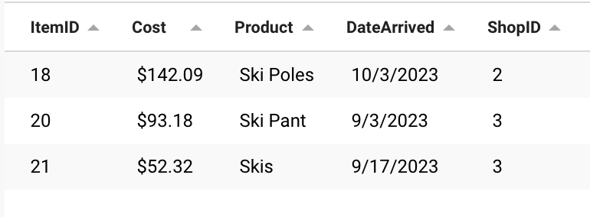
Query Report #2 Output
Notes:
Laura

Slide 12
Query Report #3
Purpose
SQL Commands
The purpose is to retrieve the average commission rate and hourly pay for each sales associate type.
This is helpful for understanding employee performance and compensation.
SELECT SType, AVG(CommissionRate) AS AvgCommissionRate,
AVG(HourlyPay) AS AvgHourlyPay
FROM Sales
GROUP BY SType;
.
Notes:
Lauren

Slide 13
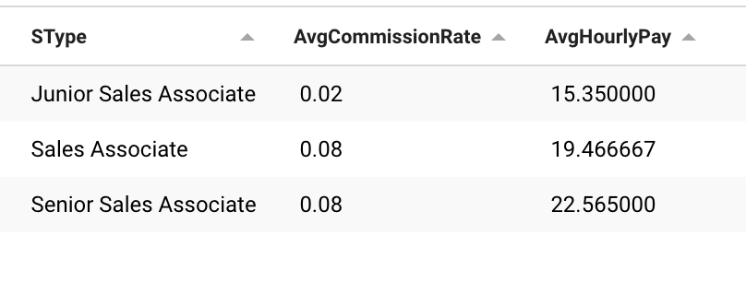
Query Report #3 Output
Notes:
Lauren

Slide 14
Query Report #4
Purpose
SQL Commands
For employee management, the purpose of this query is to find out which employees have worked the longest at Ellise.
Based on this information, Ellise can create a promotion to reward the loyalty of these employees.
SELECT SSN, FirstName, LastName,
DATEDIFF(CURDATE(), STR_TO_DATE(HireDate, '%m/%d/%Y')) as DaysEmployed
FROM Employee
ORDER BY DaysEmployed DESC;
.
Notes:
Lauren

Slide 15
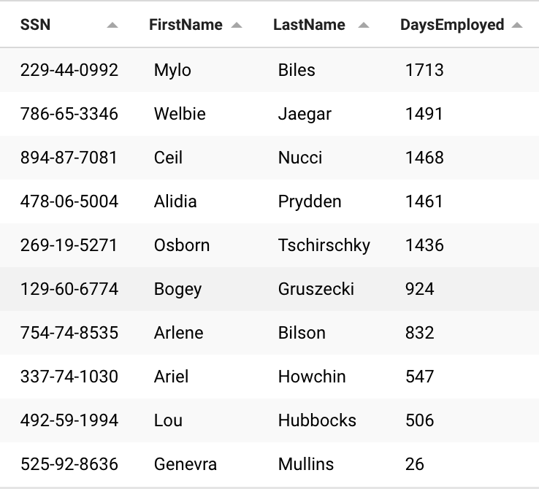
Query Report #4 Output
Notes:
Lauren

Slide 16
Query Report #5
Purpose
SQL Commands
The purpose of this query is to display the total number of day that goods have been rented, some of which have been rented multiple times, which we had to account for in our SQL commands.
This query also shows the total revenue from the rented goods based on the price per day and total days rented.
Based on this information, Ellise can determine which rented goods are the most popular and have contributed the most to the revenue.
SELECT Rentals.*,
IFNULL(T1.TotalDaysRented, 0) AS TotalDaysRented,
FORMAT(IFNULL(T1.TotalDaysRented, 0) * (REPLACE(Rentals.PricePerDay, '$', '') + 0), 2) AS TotalRevenue
FROM Rentals
LEFT JOIN (
SELECT
ItemID,
SUM(DATEDIFF(
STR_TO_DATE(ReturnDate, '%m/%d/%Y'),
STR_TO_DATE(RentalDate, '%m/%d/%Y')
)) AS TotalDaysRented
FROM Rent
GROUP BY ItemID
) AS T1 ON Rentals.ItemID = T1.ItemID;
.
Notes:
Lauren

Slide 17
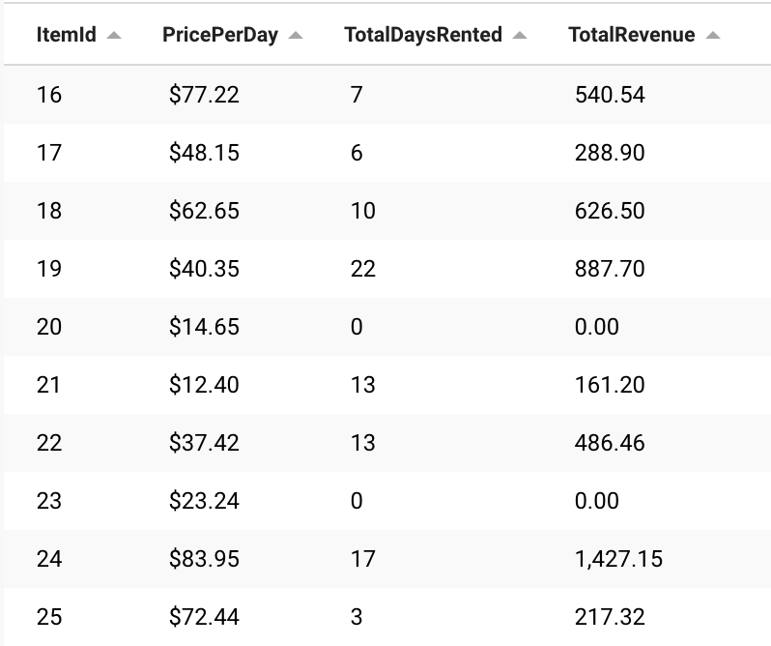
Query Report #5 Output
Notes:
Lauren

Slide 18
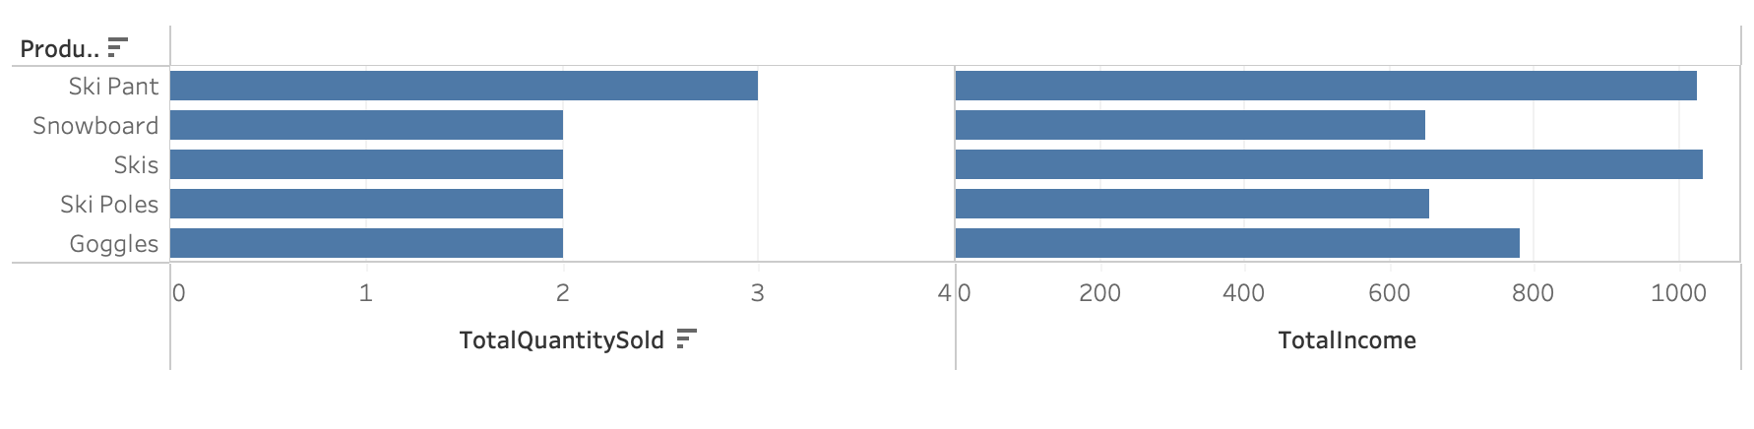
Visualizations
<Query 1>
Notes:
Liren

Slide 19
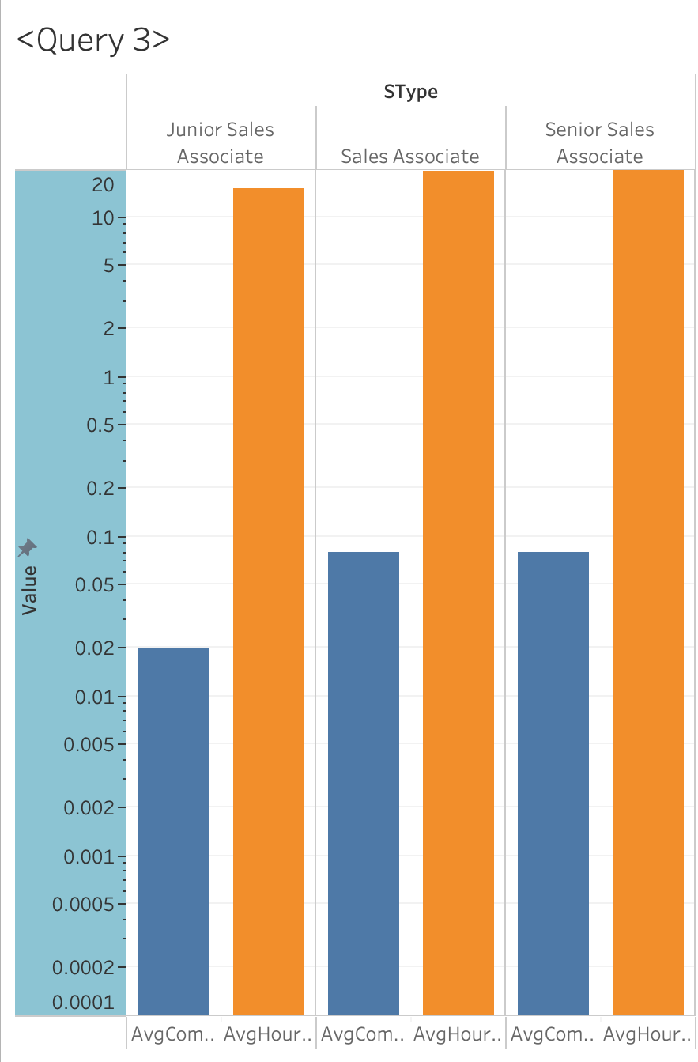
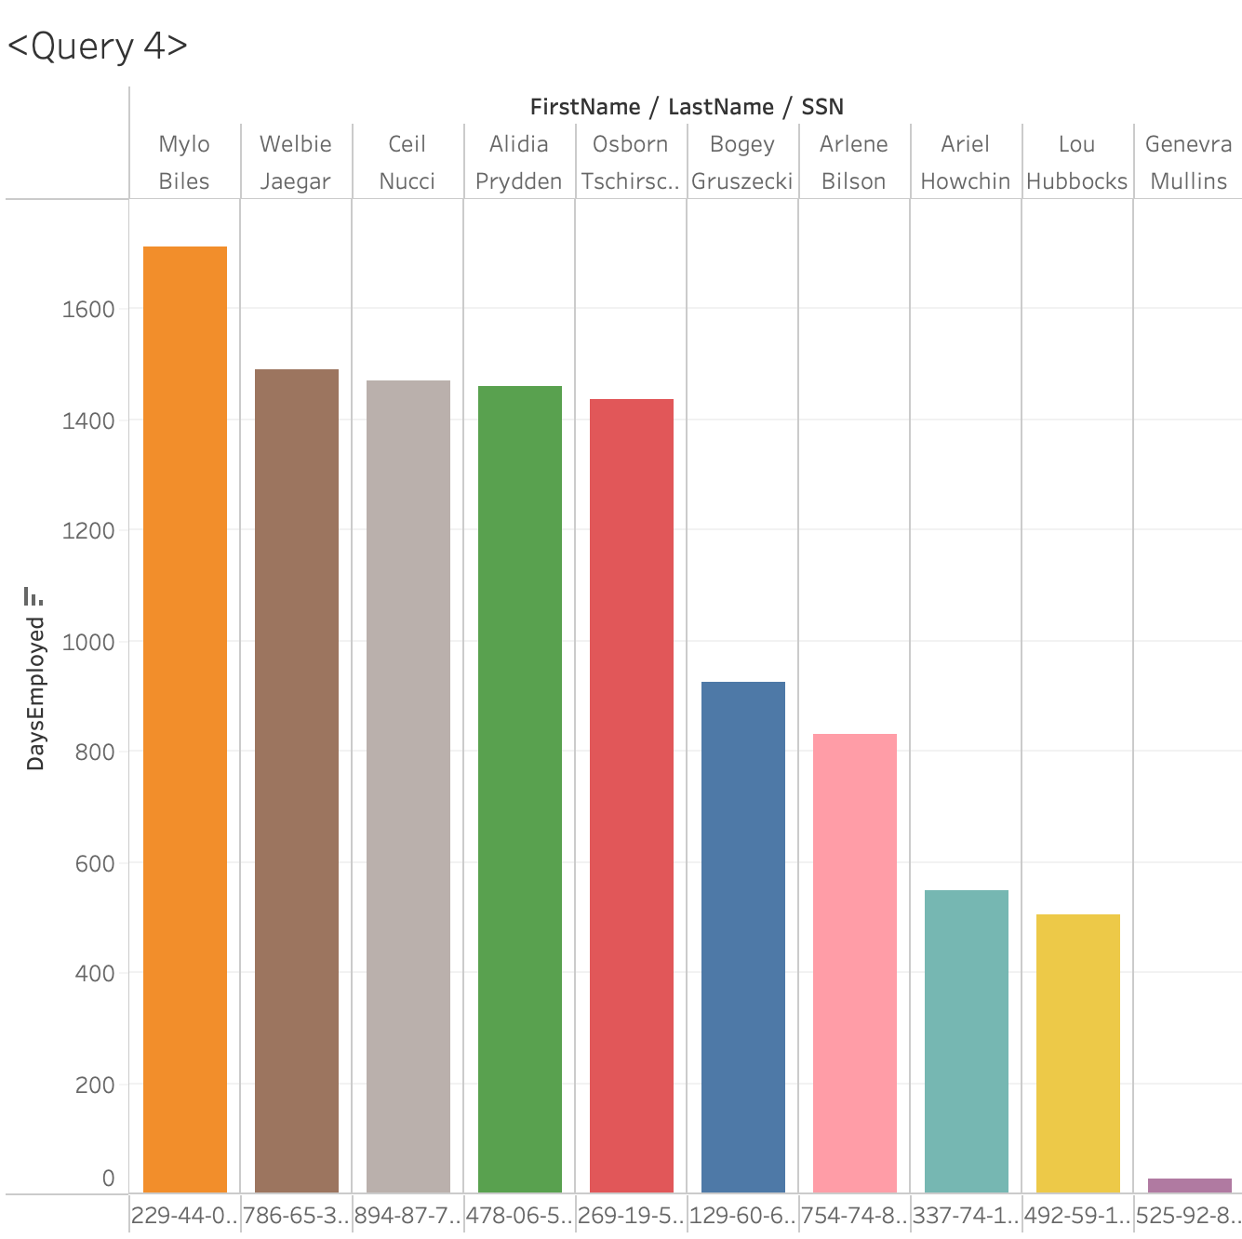
Visualizations
Notes:
Liren

Slide 20
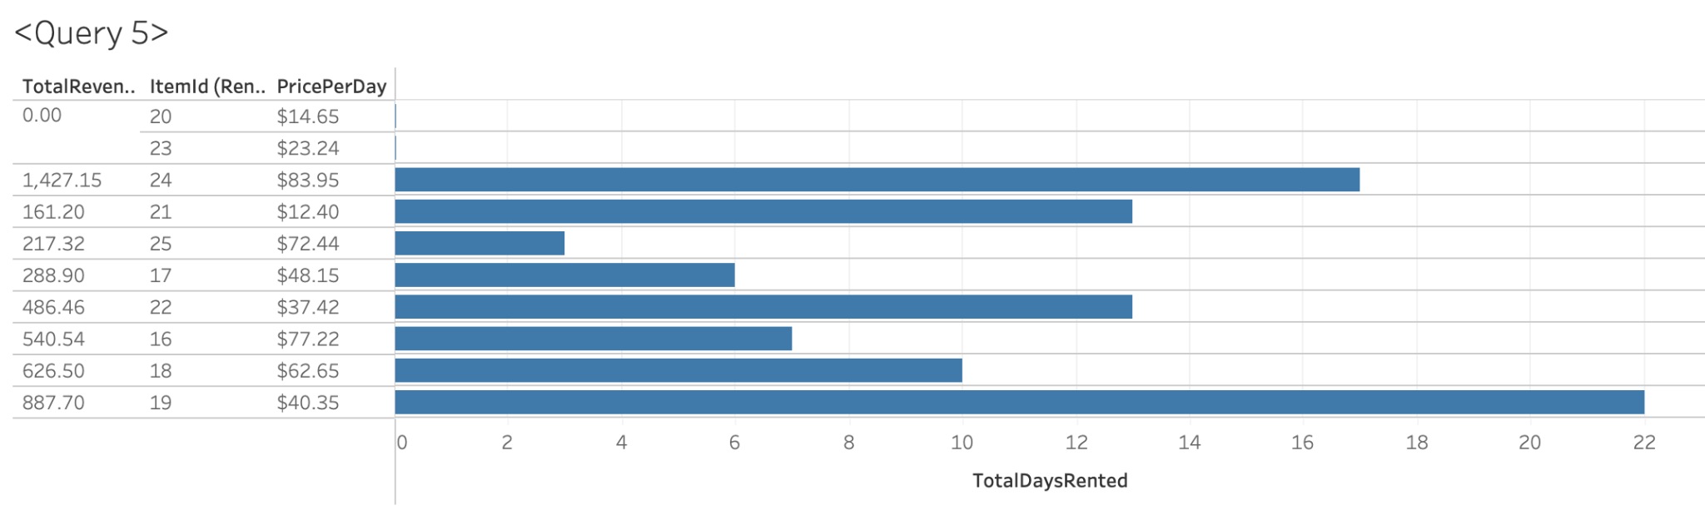
Visualizations
Notes:
Liren

Slide 21
Lessons Learned & Future Directions
Through working on this project, we learned more about the practical application of ER diagrams, relational schema, and SQL queries.
One particular obstacle that we encountered was that SQL interpreted the currency values in our database as a string. We were able to adjust this issue by replacing the $ and then converting the value to a decimal.
One direction for the future is to plan for database scalability to accommodate potential future growth in the number of shops, merchandise, and customers of Ellise.
Another way to improve upon this database is to incorporate a feedback mechanism, so that both customers and employees can review their experience with Ellise.
Notes:
Lauren

Slide 22
Thanks!
Please keep this slide for attribution
Notes:
Lauren

